Slide 1
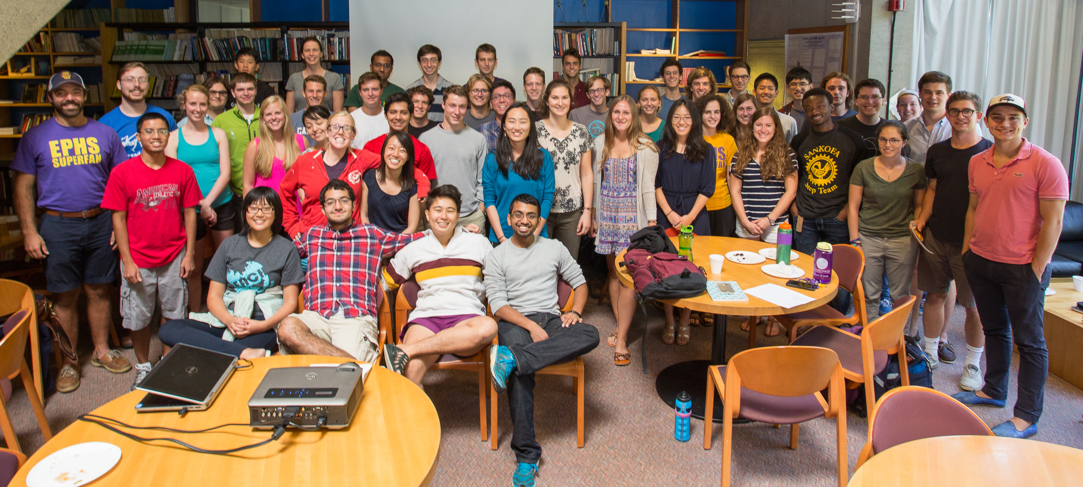
Katie Bennett
Shadman Rahman
Alex Kling
Nick Scaglione
Blake Mackall
Joel Li
Matt Rock
Max Elgart
Sam Donow
John Damstra
Ben Kaufman
Peter McDonald
Jeff Wang
John Berry
Alex Flick
Jace Forbes-Cockell
Xiaoxun Jiang
Gabe Staton
Daniel Potter
Yaroslav Nemenov
Frank W.
GK
LL
GF
CO
Jane Thompson
MH
SC
AS
Lucy Page
DT
Matt Tarduno
Eva Fourakis
Emmanuel Daring
Emily Berg
Amanda Siedem
Karen Huan
Jillian Stallman
Rachel Weiting
Nicole Feshbach
Willem Humes
Steven Louis-Dreybus
Logan Jester
Julius Collado
Mary Gong
Liz Franks
Roger Vargas
Xixi Edelsbrunner
Sarah Wu
Ashwin Naragan
DT = Diwas Timilsina, GF = Greg Ferland, GK = Greg Kehne, CO = Chris Owyang, MH = Merritt Harlan, SC = Sophie Chatas,
AS = Alexis Savery, LL = Lawrence Luo
Alex Flick
DT
Joel Li

